Slide 1

Virtual Socket on a Chip – vSOC
Demo – Presentation
Date: 5/12/2018
SEIS 635-01 Software Analysis and Design
Graduate Programs In Software
Team Members:
1. Christophe Labarere
2. Sinith Leng
3. Robert Roy
4. Surjan Kshetri

Slide 2
INTRODUCTION
The goal of this project is to make a GUI front end application for an Independent Study Project for a Master Program in Software Engineering. The project in his current state does not include a GUI interface. It support only a Text/CLI type interface.
The GUI will provide the following features:
1.) GPIO - Inputs to set an ON/OFF option (dynamic number supported)
2.) GPIO - Outputs to display an ON/OFF value (dynamic number supported)
3.) LED options for GPIO outputs
4.) PWM – Pulse width modulation input to drive Fan TAC output
5.) Completely file driven configuration/setup to support test automation
6.) TCP/IP socket interface with vSOC Platform Server
7.) Temperature Sensor Inputs
8.) Transactions log files for all interfaces

Slide 3
Scope
Build a GUI front end application for the Virtual System on a Chip (vSOC) project. The GUI interface will be a web based front end and should support a TCP/IP socket connection to the existing backend vSOC platform server.

Slide 4
Business Case
Business Justification
Improve the usability of the vSOC platform, by replacing a text based command line interface (CLI) with an intuitive graphical user interface (GUI).
Make the GUI platform independent by creating a web based application
Provide an interface to allow the use of personality/sequence scripts that would facilitate automated testing/simulation.
Create an easily configurable interface, so many different virtual platforms could be easily supported.

Slide 5
Risks
This project was built using new tools and frameworks. Hence, a learning curve was needed to get up to speed and to develop the software within the given timeline.
We also decided to adopt a Test Driven Development (TDD) approach rather than spending time on documentations we decided to focus on “the ultimate artifact” : the code. We are firm believer of Agile Manifesto:
…
“Working software over comprehensive documentation”.
…
Finally, a familiarity with Spring Boot, Thymeleaf and Web application development was needed. We managed to overcome those challenges and bring the whole team up to speed on these new technologies.

Slide 6

List of Supported Features: I/O Elements

Slide 7
Additional Features (Future works)
1.) Implement a file driven configuration/setup 2.) Ability to configure range of inputs for specified interfaces
3.) Transactions log files for all interfaces
4.) CI/CD implementation of Infrastructure as code

Slide 8

Before and After Architecture/Features
Before
After
Web based UI to:
Send inputs to the vSOC Platform Sever
Display inputs sent to the vSOC Platform Sever
Read outputs from the vSOC Platform Sever
Manual process:
Text/CLI entries for inputs and outputs to the vSOC Platform Server

Slide 9
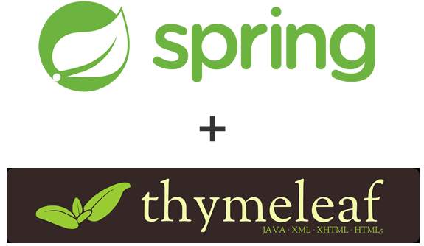
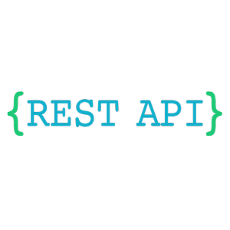


Tools Used

Slide 10
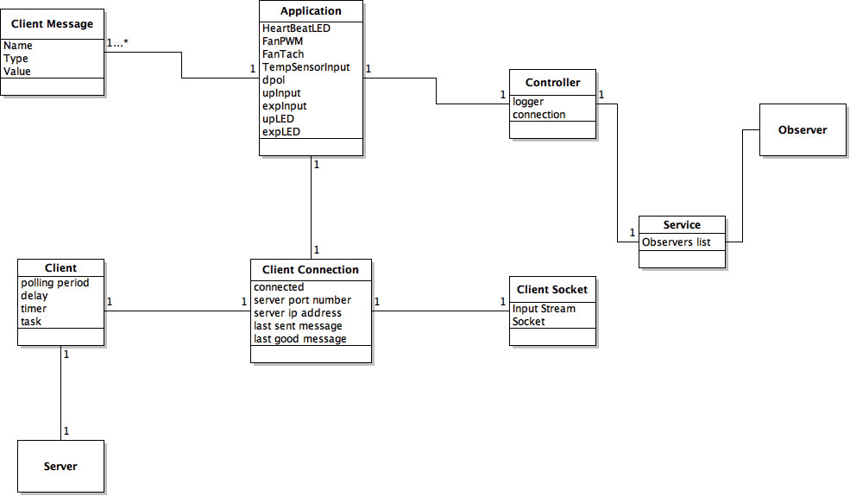
BASE APPLICATION ARCHITECTURE
Domain Class Diagrams

Slide 11
BASE APPLICATION ARCHITECTURE
UML Class Diagrams

Slide 12

BASE APPLICATION ARCHITECTURE
Model
View (Thymeleaf Template)
Thymeleaf Engine

Slide 13
BASE APPLICATION ARCHITECTURE
Thymeleaf Engine

Slide 14
Deploy/RUN the Application
GUI Front End for the Virtual System on a Chip (vSOC).
1. To compile & run "tp_3_vsoc_gui" application using maven
mvn clean package
2. run the application
mvn spring-boot:run
-- you should see the following message:
Tomcat initialized with port(s): 8000 (http)
-- alternate solution: run VSocApplication.java as springboot application
3. test the application
open the browser and type: http://localhost:8000/vsoc/

Slide 15
Handoff to Rob For demo

Slide 16

Q&A
Thank you

